Slide 1
6. Liberal democracy
Knowledge seminar

Slide 2
Summary of RoW’s classification criteria
 | Are there elections for president/ PM/ parliament? | Are the elections free, fair and meaningful? | Do citizens have full civil rights and are equal before the law? | Is there a separation of powers (legislative and judiciary can constrain the executive)?
Closed autocracy | No | n/a | No | No
Electoral autocracy | Yes | No | No | No
Electoral democracy | Yes | Yes | No | No
Liberal democracy | Yes | Yes | Yes | Yes

Slide 3
Direct democracy Vs representative democracy
Direct democracy:
= everyone votes on an issue, without any representatives.
Representative democracy:
= people vote for representatives, who then make policy decisions on their behalf.
Modern nation states use representative democracy because direct democracy is impractical in large states.
An occasional exception: referendums (= direct democracy).

Slide 4
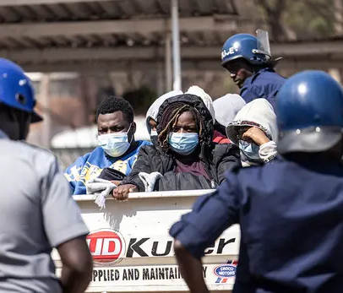
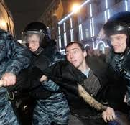
‘Free, fair and meaningful’ elections
Free elections:
No coercion, repression or intimidation (of candidates or their supporters)
No cancelling of candidates or parties
No restrictions on campaigning or protests
No pressure to vote for a particular candidate/party

Slide 5
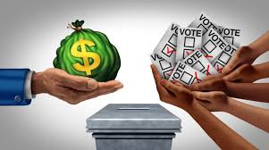
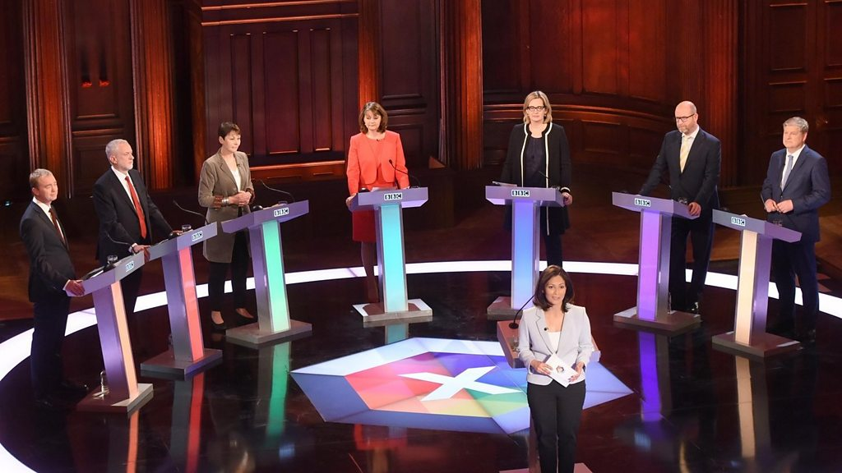
‘Free, fair and meaningful’ elections
Fair elections = impartial electoral process:
The rules are transparent and are applied equally to all candidates.
Equal opportunities for all candidates to campaign and get media coverage
The current government does not use the power and resources of the state to give itself an advantage in the election
No electoral fraud or manipulation. Votes are counted accurately.

Slide 6
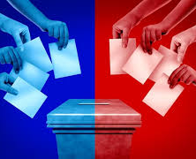
‘Free, fair and meaningful’ elections
Meaningful elections:
There is a real choice. Pluralism among candidates/parties.
The outcome has practical significance. I.e. voters can change the government and get new policies.

Slide 7
Liberal democracy
Liberal democracy combines:
representative democracy (usually = multi-party elections)
ideas of liberal political philosophy.
Liberal democracy = representative democracy (multi-party elections) + liberal institutions

Slide 8
Features of liberal democracy
Liberal democracy = representative democracy (multi-party elections) + liberal institutions
Separation of powers
The rule of law
Private property rights
Equal protection of human rights, civil liberties and political freedoms for all citizens

Slide 9
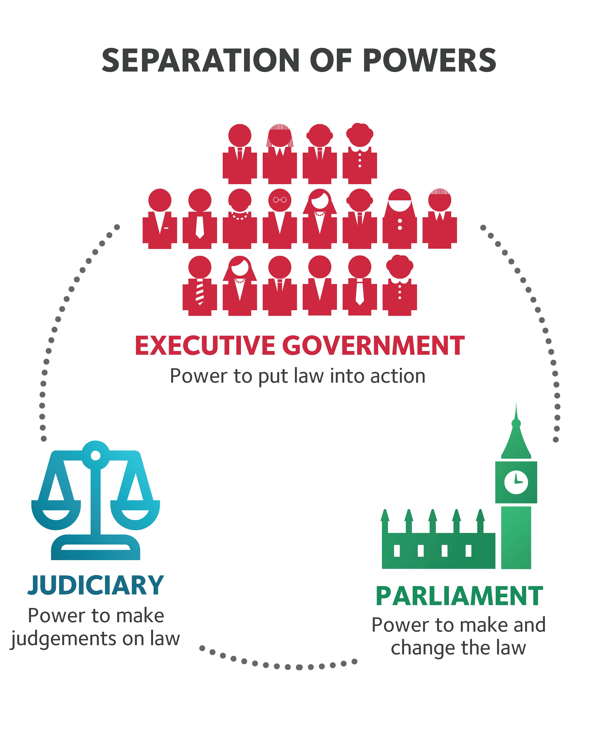
Separation of powers
Power is divided between the three branches of government:
The executive
The legislature
The judiciary
No single branch can dominate due to checks and balances

Slide 10
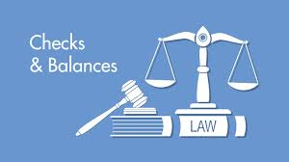
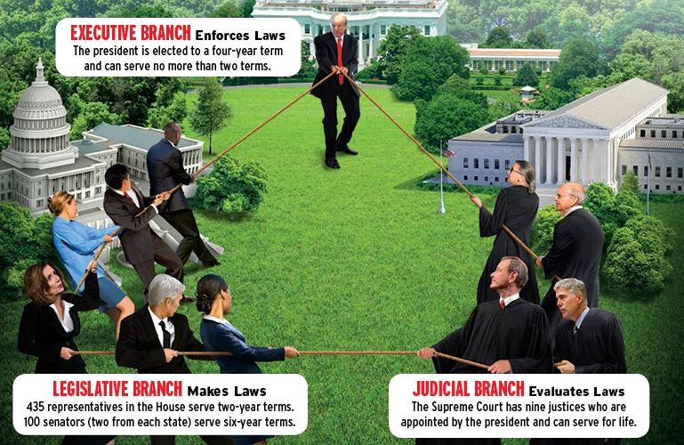
Checks and balances
Mechanisms which support the separation of powers.
They prevent any one institution or individual from exercising total control.
Checks = the mechanisms which allow one political institution to limit political institution’s power (e.g. by blocking, delaying or criticising decisions).
Balances = mechanisms ensuring that power is balanced.

Slide 11
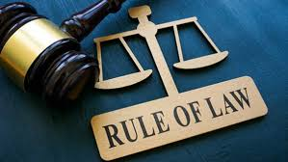
The rule of law
The law applies to everyone equally
No one is above the law
The judiciary is independent
Laws are clear and easy to understand and follow
The law is applied consistently (no ‘selective enforcement’)
Laws must not be applied retroactively

Slide 12
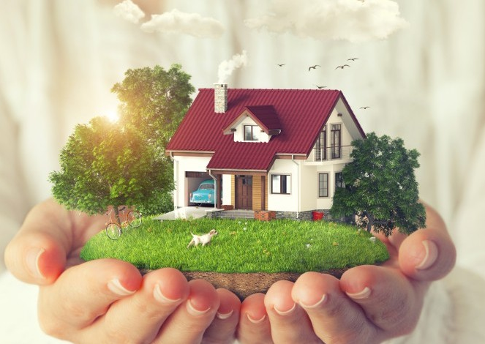
What is meant by ‘property rights’?
People have the right to own property (имущество)
No one has the right to take your property, not even the government

Slide 13
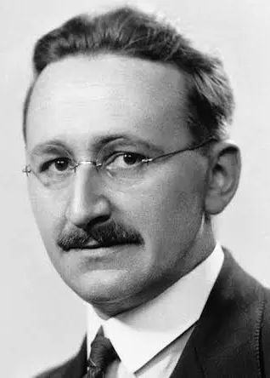

What was the name of Friedrich Hayek’s book published in 1944?

Slide 14
Why did Hayek believe that private property rights are a fundamental part of liberal democracy?
Hayek: Private property rights are the most important guarantee of freedom
Property = power
When many people own property, it prevents a single entity (e.g. the state or a dictator), from having complete power over individuals
Property rights thus create a protected space against state control
Hayek saw what was happening in the USSR, where private property rights did not exist. All property belonged to the state, which meant it could control people’s lives

Slide 15

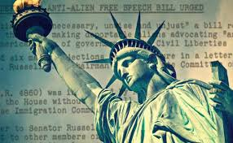
Civil liberties
freedom of speech
freedom of the press
Internet freedom
freedom of association
freedom of assembly
We will look at 4 and 5 in week 8 when we study civil society

Slide 16
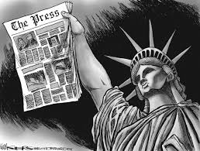

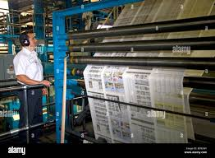
Freedom of the press
Freedom of the press* = the right of journalists and media organisations to publish news and express opinions without government control or censorship.
Freedom of the press = media freedom
* ‘The press’ means newspapers.

Slide 17
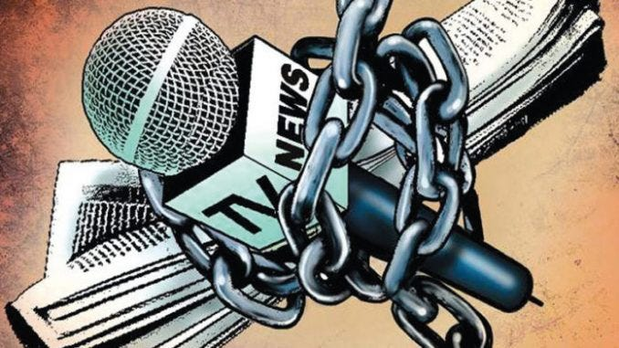
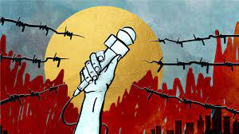
Why is freedom of the press considered an important principle in liberal democracy?
Watchdog journalism: journalists expose any wrongdoing by those in power (e.g. corruption, abuse of power)
To keep citizens informed about government policies so they can make an informed choice at elections

Slide 18

News of the World phone hacking scandal (2009-2011)
Journalists at the British newspaper the News of the World used illegal and immoral practices to get big stories:
hacking people’s private voicemail messages
bribing public officials
Not only famous people but ordinary members of the public were targeted in this way:
relatives of British soldiers killed in action
victims of the July 2005 terrorist bombings in London
the phone of a murdered schoolgirl

Slide 19
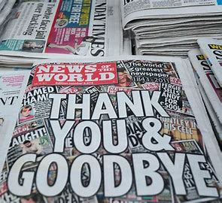
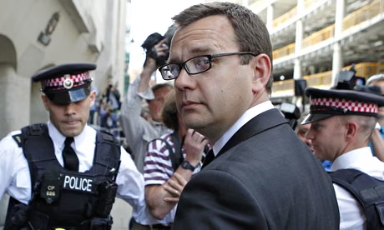
News of the World phone hacking scandal (2009-2011)
Public outcry against the newspaper’s owners, News Corporation.
Advertiser boycotts led to the closure of the News of the World in 2011, after 168 years of publication.
Several powerful people involved were sent to prison
One of them was the former News of the World managing editor Andy Coulson. Coulson had since become communications chief for the British prime minister, David Cameron.

Slide 20

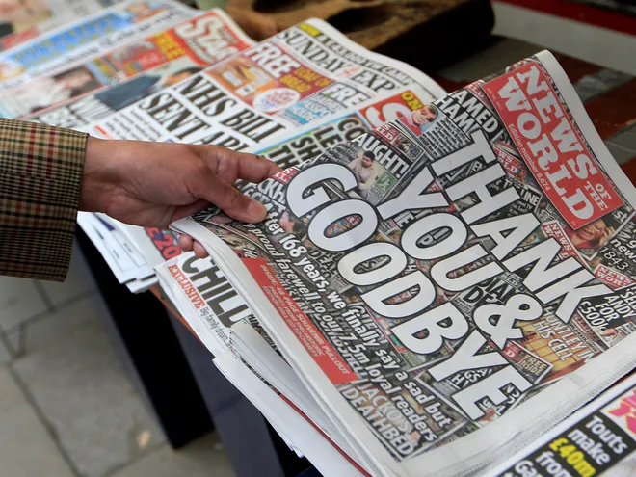
What does the News of the World phone hacking scandal (2009-2011) teach us about freedom of the press?
Sometimes journalists and media organisations also act unethically and even illegally
Therefore some degree of media regulation is necessary
On the other hand, too much regulation could potentially stop important investigative reporting
It is difficult to find the right balance between media freedom and regulation

Slide 21
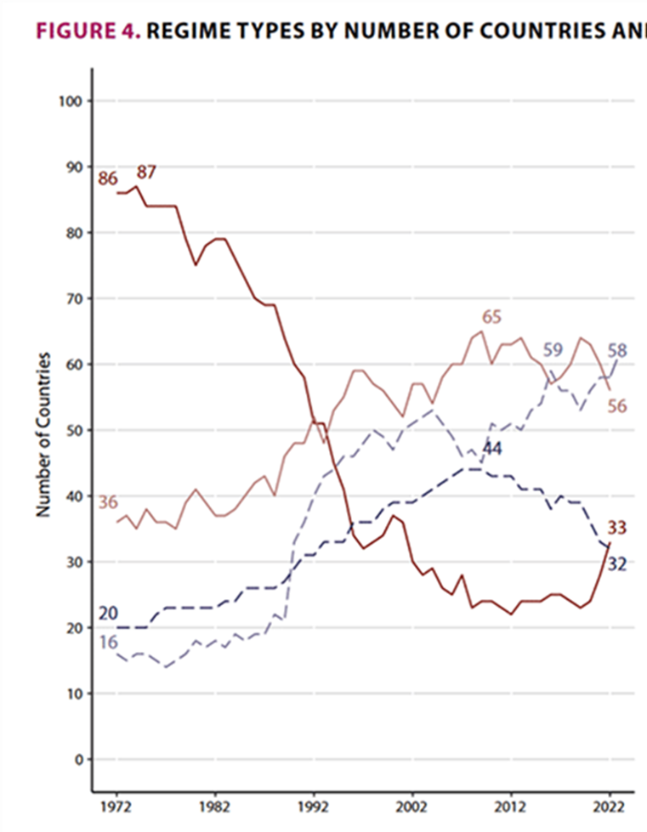
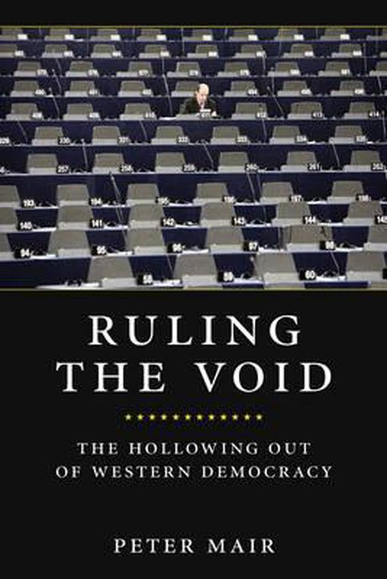
Is liberal democracy in crisis?
Liberal democracies
Why do some scholars think that liberal democracy is currently facing a crisis?
What did the political scientist Peter Mair say on this topic?
What did Peter Mair mean by ‘the void’?

